Slide 1
Diffusion

Slide 2
Contents
General Introduction
Diffusion
  Diffusion Mechanism
  Furnace Layout
  Dopant Sources
  Diffusion Model
  Junctions

Slide 3
Introduction
Introducing dopants into the silicon crystal can alter the “type” of the silicon
  from n type to p type and vise versa
Dopants are usually introduced in a two stage process
Predeposition and Drive-in
Implant and Drive-in (anneal)

Slide 4
Doping the Silicon
POLY
BPSG
- - - - -
P+
+++++++++
P+
- - - - - -
Field
Implant
P+ Source
Drain
N WELL
Vt Adjust

Slide 5
Doping the Silicon 2
In older processes the Source /Drain regions were doped using Thermal Diffusion
With the maturing of implant technology CMOS processes became possible because of the greater control over the dopant quantities introduced to the silicon
In modern CMOS processes all of the doping with the exception of the saturation doping of polysilicon is done by implantation

Slide 6
Diffusion Mechanism
Particles naturally diffuse (move) from areas of high concentration to areas of low concentration
The mechanisms by which dopant atoms move in the silicon crystal are twofold
Substitutional
  movement of the atoms from vacancy to vacancy in the crystal
Interstitial
  Movement of small dopant atoms between the atoms of the silicon crystal

Slide 7
Substitutional Diffusion
Dopant atoms move from vacancy to vacancy in the silicon crystal
Thermal energy causes vibrations which dislocate silicon atoms from their position in the crystal
At the elevated temperatures of diffusion furnaces there are sufficient vacancies to allow large dopant atoms to diffuse through the silicon

Slide 8
Interstitial Diffusion
Some dopant atoms are small enough to move between the atoms of the silicon crystal
They are not dependant on finding vacancies in the crystal for movement
To become “electrically” active they must come to rest in a vacancy site
Boron is one such dopant

Slide 9
Two Stage Process
Thermal introduction of dopant into the silicon is usually done as a two stage process
The first of these steps is called predeposition
Predeposition loads the surface of the silicon with a large quantity of dopant
This dopant is then driven to the required depth during the drive in stage
The quantity of dopant introduced is somewhat uncontrolled as the surface of the silicon is saturation doped

Slide 10
Selective Doping
P/N junctions are formed in selected areas through
  oxidation
  Photolithography
  etching
Holes are opened in the oxide the dopant can reach the silicon through these holes
The oxide acts as a diffusion barrier to the dopant in the other areas

Slide 11
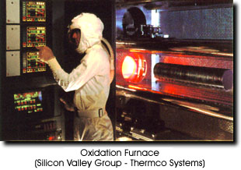
Equipment
Same furnace arrangement as for oxidation
Either vertical or horizontal furnace orientation can be used

Slide 12
Dopant Sources
During the predeposition stage the ambient in the furnace is rich in the dopant required
This dopant can come from
  solid sources
  liquid sources
  gas sources
Most processes use either solid or liquid sources as gas sources for the type of materials in question are quite dangerous

Slide 13
Sources
Liquid sources
  Boron - BBr₃
  Phosphorous - POCl₃
Solid sources
  Boron - Boron nitride or B₂O₃ disks
  Phosphorous - P₂O₅ disks

Slide 14
Liquid Sources
Liquid sources are usually delivered to the furnace from a bubbler system
A carrier gas is passed through a temperature controlled flask of the liquid
The gas (nitrogen) picks up some of the source and delivers it down the tube
Gas in
Gas out
Temp. controlled flask

Slide 15
Solid Sources
Solid Source Disk
Silicon Wafer

Slide 16
Typical Reactions
Boron
  Liquid - 4 BBr₃ + 3O₂ ---> 2B₂O₃ + 6Br₃
  Solid - 2B₂O₃ + 3Si ----> 4B + 3SiO₂
Phosphorous
  Liquid - 4POCl₃ + 3O₂ ----> 2P₂O₅ + 6HCl
Most reactions involve the formation of an oxide of the dopant on the silicon surface this oxide then actually acts as the source of dopant into the silicon

Slide 17
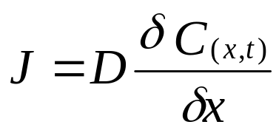
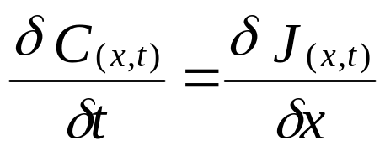
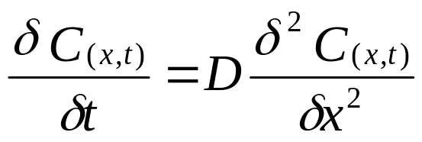
Diffusion Model
The model which describes the doping of silicon is based on Ficks Law
1
From the law of the conservation of matter, the change in concentration over time must be the same as the decrease in the flux (local)
2
Substitute equation 1 into 2
3

Slide 18
Model Assumptions
We need to look at two sets of different initial conditions and Boundary condition assumptions for predeposition and drive-in
  Predeposition - Constant Source Diffusion
  Drive-in - Constant Total Dopant Diffusion

Slide 19
Predeposition Initial and Boundary Conditions
Initial Condition
  at t=0 C_{(x,t)}=0
Boundary Conditions
  C_{(0,t)}=C_{s} -The surface concentration remains constant, at the solid solubility of the dopant in silicon at the process temperature
  C_{(∞,t)}=0 -At a point “very” deep into the silicon there is no dopant, the solution is for activity close to the surface

Slide 20
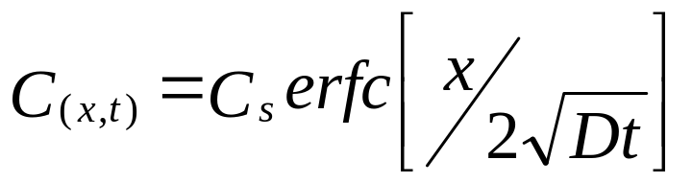
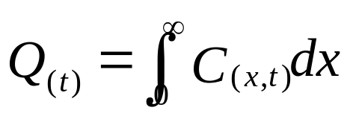
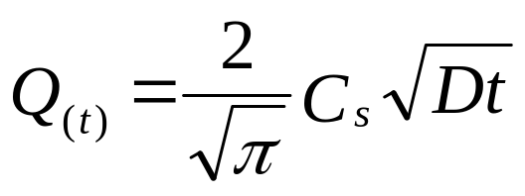
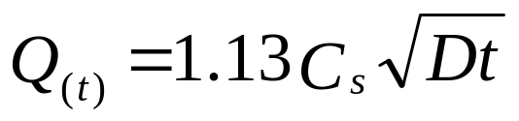
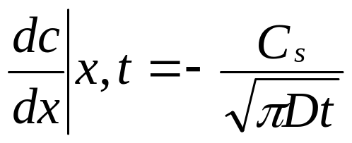
Predeposition Solution
The solution to equation 3 which satisfies the initial and boundary conditions is:
As time progresses the dopant penetrates deeper into the silicon, the surface conc remains constant, so the total dopant quantity is increasing
The gradient is:

Slide 21
Predeposition
The un limited supply of dopant means that the surface concentration goes to the solid solubility and remains at that for the duration of the furnacing
The longer the wafers remain in the furnace the deeper into the silicon the dopant goes
Conc.
Solid Solubility Limit
Cs
t3
t2
t1
0
X
Depth into the silicon

Slide 22
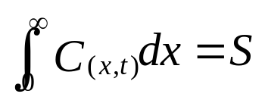
Drive-In Initial and Boundary Conditions
Initial Condition
  at t=0 C_{(x,0)}=0
Boundary Conditions
  -No matter how long the process goes on there is only a constant amount of dopant available
  C_{(x, ∞)}=0 -After a “very” long time the finite quantity of dopant would be so dispersed (diffused) as to be not there

Slide 23
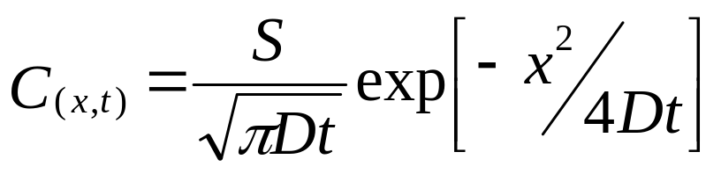
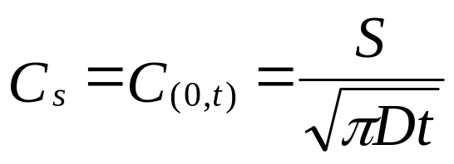
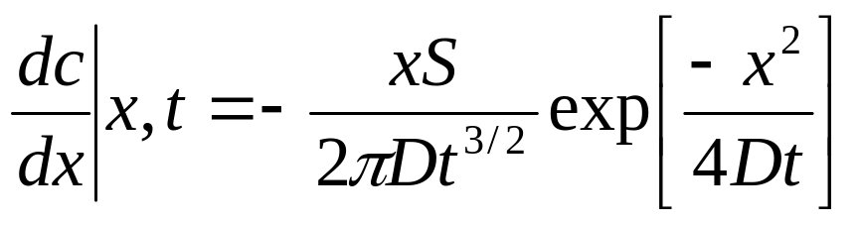
Drive-In Solution
The solution to equation 3 which satisfies the initial and boundary conditions is:
By setting x=0 we can get the surface concentration
The gradient is

Slide 24
Drive-in
A fixed amount of dopant remains in the silicon from the predeposition stage
This is the only dopant available for diffusion
As the dopant diffuses deeper into the silicon the surface concentration is reduced
The total dopant quantity remains the same throughout the drive-in process
The drive-in generally takes place in an oxygen environment which also reoxidises the hole opened for the predeposition
Conc.
Cs 0
Cs 1
Cs 2
Cs 3
t3
t1
t2
0
X
Depth into the silicon

Slide 25
Full Process Flow
Pre Furnace Clean
Predeposition
Deglaze
  to remove the oxide/glass formed during predep
Drive-in

Slide 26
Junction Formation
The junction between the P/N region occurs where the concentration of the introduced dopant is equal to the background dopant concentration
Conc.
Cs
diffused dopant
background
Cb
N
0
x_{j}
X
x_{j}
P

Slide 27
Thermal Diffusion Summary
In modern processes Predep/Diffusion is not used where control over the dopant quantity and surface concentration is important
Is still used where saturation doping is needed (Polysilicon doping)
Most processes would use an Implant/Thermal cycle

